Slide 1
ENG1003 Freshman Seminar for Engineering AAE Design of Path Planning Algorithm for Aircraft Operation Week 3: Introduction to Path Planning, Python and GitHub
Dr Li-Ta Hsu and Dr Weisong Wen
Assisted by
Man Hei CHENG (Melvin), Miss Hiu Yi HO (Queenie), Miss Yan Tung LEUNG (Nikki)

Slide 2
Lecturer’s Information
Instructor: Dr Li-Ta HSU
Office: QR828
Phone: 3400-8061
Email: lt.hsu@polyu.edu.hk
Office Hour: by appointment
Expertise: GPS navigation, Autonomous driving, Pedestrian localization using Smartphone, Sensor Integration

Slide 3


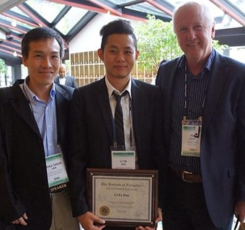
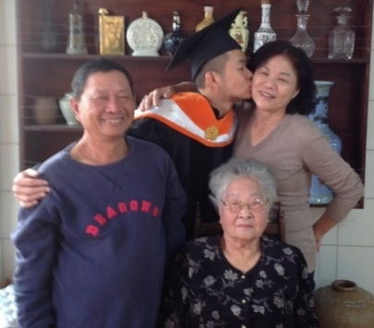
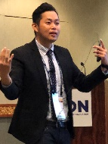
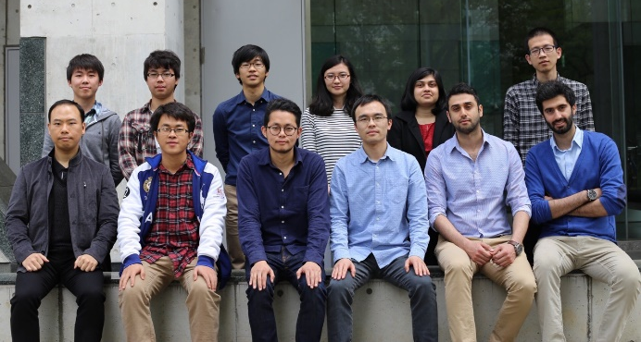
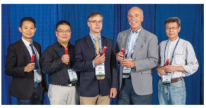
Li-Ta HSU
1985.08 – Born in a fish farmer family in Tainan, Taiwan
2003.06 – Graduated from Kang Ming Senior High School, Taiwan
2007.06 – Bachelor of NCKU Department of Aeronautics and Astronautics (DAA), Taiwan
2010.09 – Ph.D. Candidate of NCKU DAA, Taiwan
2012.02 – Visiting Researcher in University College London, UK
2012.06 – Part-time Consultant for Spirent, UK
2013.07 – Visiting Researcher in Tokyo Marine University, Japan
2013.12 – Ph.D. of NCKU DAA, Taiwan
2014.04 – Postdoctoral Researcher in the University of Tokyo , Japan
2017.05 – Assistant Professor in AAE of PolyU, Hong Kong
2021.07 – Associate Professor in AAE of PolyU, Hong Kong

Slide 4
Ground Rules
For students
For teaching staffs
Try to speak as much English as possible.
Participate the class activates assigned.
Reply your email with 3 working day.
Open to any question regards to the subject
For us!
Keep an open mind—enter the classroom dialogue with the expectation of learning something new. Look forward to learning about–and being challenged by–ideas, questions, and points of view that are different than your own.
Arrive on time to the class and finish the class on time

Slide 5
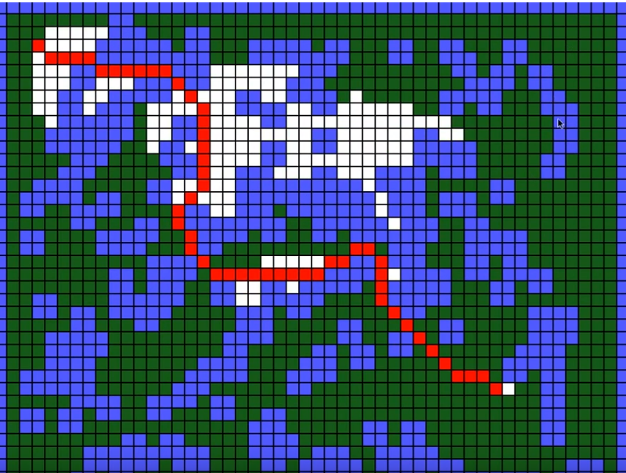

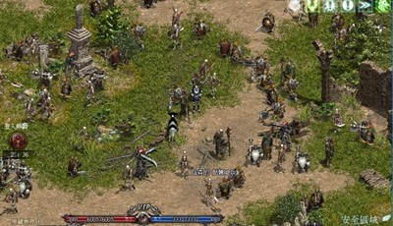

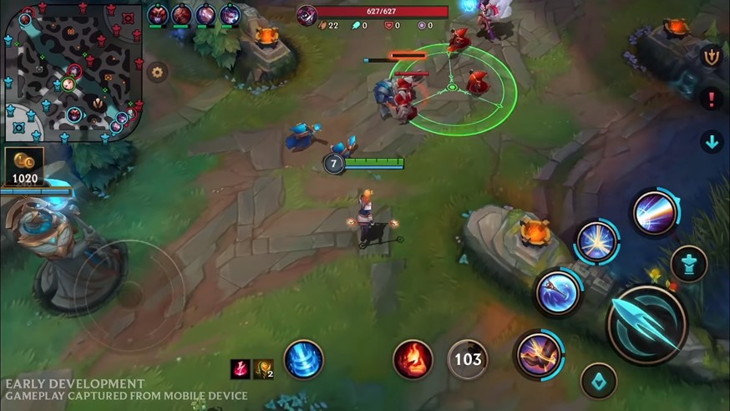
What is Path Planning?
How to go from A to B considering factors!
Path planning (also known as the navigation problem) is computational problem to find a sequence of valid configurations that moves the object from the source to destination. The term is used in aviation, robotics and computer games.

Slide 6
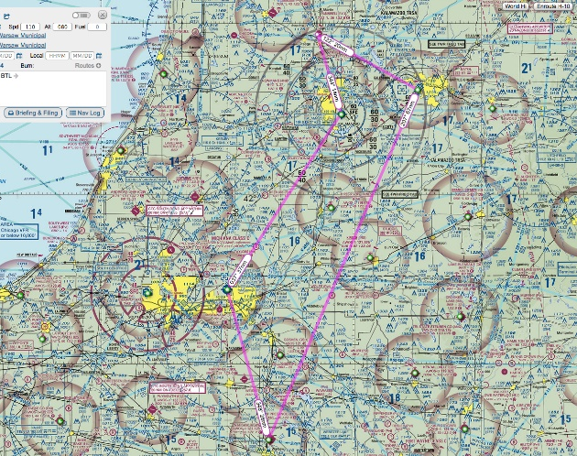
How is Path Planning important to Aviation Engineering?
Private pilots do the path plan before the flight to make sure the navigation aid is available
Objective: Safe and Best Sight Seeing

Slide 7
How is Path Planning important to Aviation Engineering?
For ATC near airports, collaborative path planning is required to make the best use of the crowded airspace
Objective: Safe and least delay

Slide 8
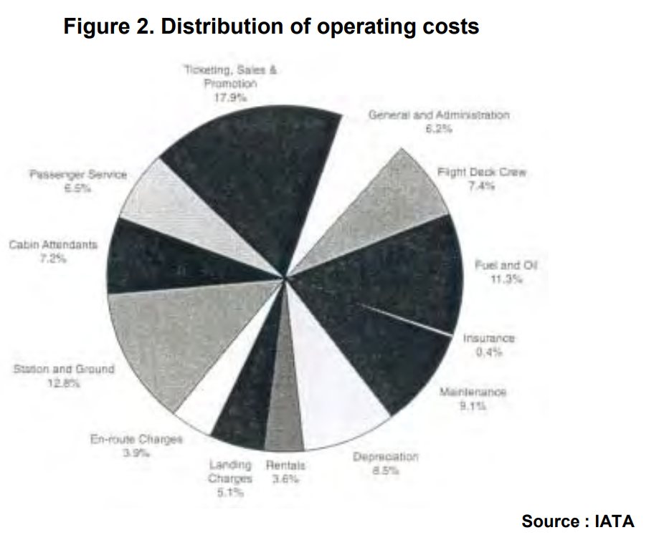
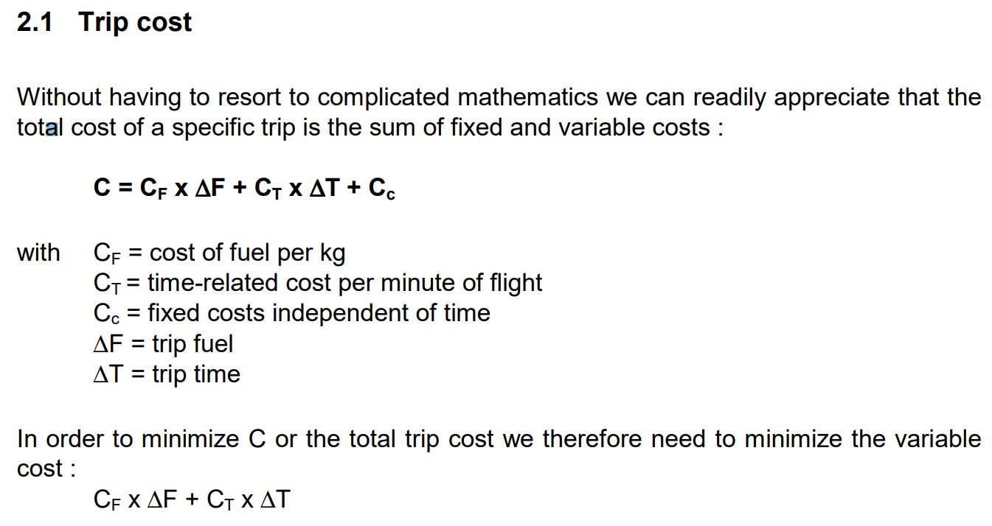
How is Path Planning important to Aviation Engineering?
Commercial pilot follow the path that plan based on different cost index designed by airlines.
Objective: Safe and Minimum Cost
Flight deck crew 7.4 %
Cabin Attendant 7.2%
Fuel and Oil 11.3%
Maintenance 9.1%
En-route change 3.9%
Landing change 5.1%
https://ansperformance.eu/library/airbus-cost-index.pdf

Slide 9
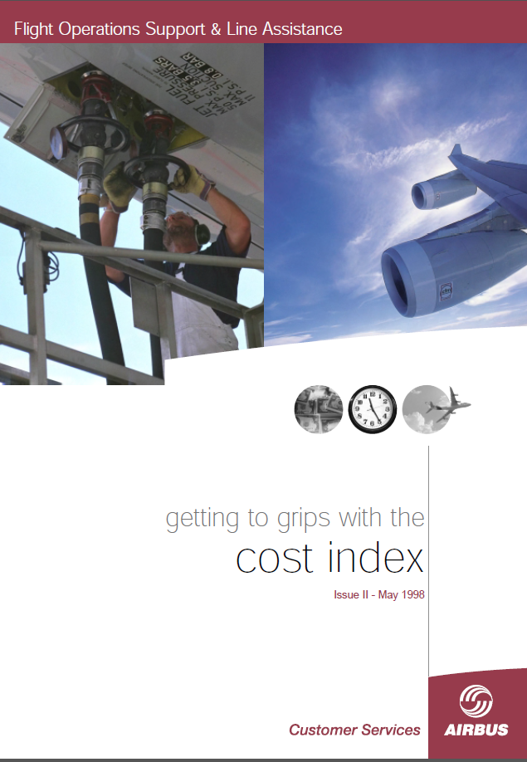
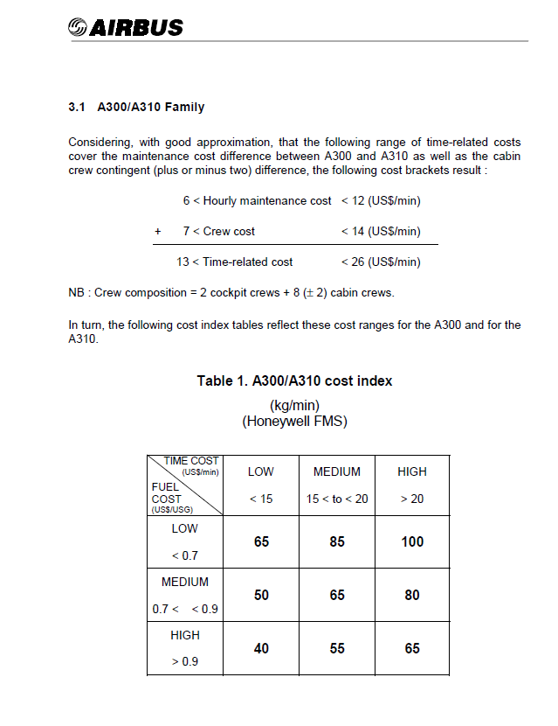
Cost-Index Published by Aircraft Manufacturer
https://ansperformance.eu/library/airbus-cost-index.pdf

Slide 10
Aircraft Operation in Flight Control System
Path Planning
Desired Waypoints, Destination and More
Desired Speed, Height and Heading
Desired Pitch, Yaw and Roll Angles
Change of Elevator, Rudder and Ailerons Positions
Change of Pitch, Yaw and Roll Angles
Database
Airline Plan
Pilot
FMS
Autopilot
FBW
Flight Mechanics
Integration
Position, Velocity and Rotation of the Aircraft
Gyroscopes
Air Data Sensors/Computer
Magnetometer/
AHRS/IRS/GPS
GPS/VOR/DME
VHF/HF by ATC
ADS-B/TCAS

Slide 11
How is the Freshman Project related to the AE programme study?
Mathematics & Physics
Computer Science
Aeronautical and Aviation
The plan should be planned considering the physical limitation (dynamics) of the aircraft

Slide 12
Path Planning
Optimization Problem:
To optimize a path that fulfilling all the constrains and by a set of certain criteria.
Goal of this project, to select the best aircraft models with an optimized route that minimized the cost of the aircraft operation under given scenario.
Design the cost of the aircraft operation
Design an aircraft model (virtually) with different cost coefficients to fly safe and cheapest.
Design the path planning algorithm considering 3D, 2D + time, scenarios.

Slide 13
Expected Outcome. Every Group have different scenarios

Slide 14
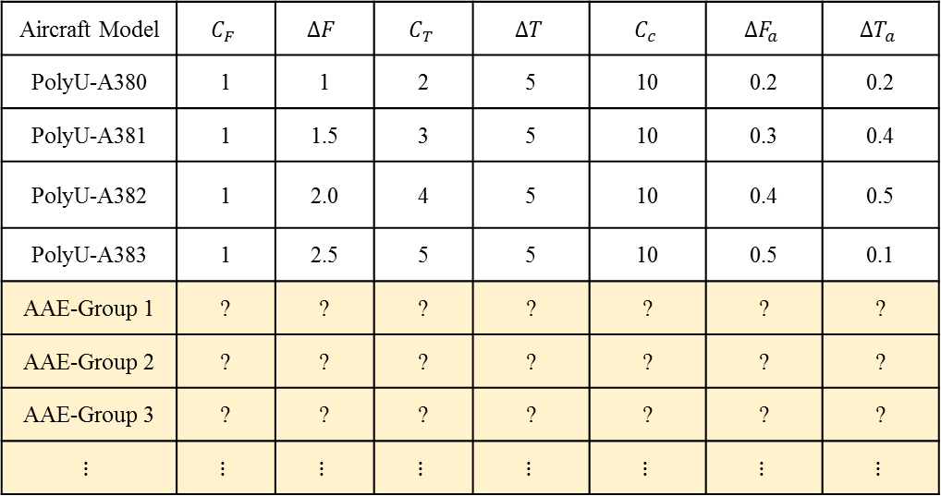
Model of Aircraft to select
Aircraft Model | $$C_{F}$$ | $$∆F$$ | $$C_{T}$$ | $$∆T$$ | $$C_{c}$$ | $$∆F_{a}$$ | $$∆T_{a}$$
PolyU-A380 | 1 | 1 | 2 | 5 | 10 | 0.2 | 0.2
PolyU-A381 | 1 | 1.5 | 3 | 5 | 10 | 0.3 | 0.4
PolyU-A382 | 1 | 2.0 | 4 | 5 | 10 | 0.4 | 0.5
PolyU-A383 | 1 | 2.5 | 5 | 5 | 10 | 0.5 | 0.1
AAE-Group 1 | ? | ? | ? | ? | ? | ? | ?
AAE-Group 2 | ? | ? | ? | ? | ? | ? | ?
AAE-Group 3 | ? | ? | ? | ? | ? | ? | ?
$$⋮$$ | $$⋮$$ | $$⋮$$ | $$⋮$$ | $$⋮$$ | $$⋮$$ | $$⋮$$ | $$⋮$$

Slide 15


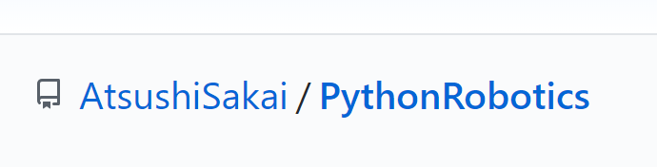
What you are expected to learn?
Academic level of algorithm designs
Design of a path planning algorithm and aircraft model cost function
2D path planning for simplicity
Make use of the open-resource to work on coding-project remotely.
Programming and coding
Python
Online coding collaboration
GitHub

Slide 16
In this project, students will be acted as
Group leader or members to collaborate on an online project,
R&D engineers to design and develop path-planning algorithm,
Project manager to present the designed code and prepare report.
Assessments
(30%) Demonstration and Presentation
(40%) Report & reflective essay – one report per group, with individual reflective essay
(20%) Log sheet – one per student after the first week
(10%) Performance/participation in in-class activities (Confidential peer evaluation)

